Slide 1
Lab 10

Slide 2
Javadocs and commenting
By now you should have gotten used to seeing comments in code and creating comments
It is good practice for you to use comments in your code, the comments in your code should explain why something is there not what it is, that should be obvious from the given name
You should used descriptive names that let other readers know what a variable, object, method, etc is.
We are going to go over using and reading Javadoc today

Slide 3
Step 1
To setup for todays lab as usual create a project in eclipse and call it Lab10
Import the Lab10.java file provided into the Lab10 src folder and open it up

Slide 4
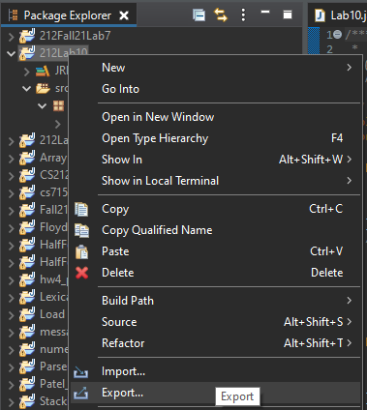
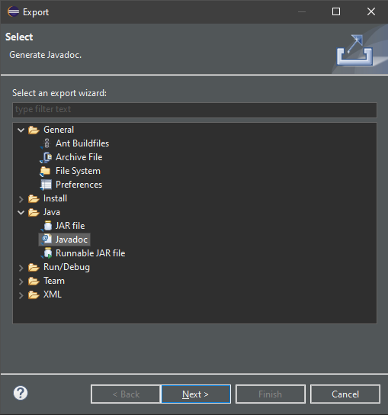
Step 2
To start exporting javadocs from eclipse we need to be configured (one-time)
Right click the Lab10 project click export and select Javadoc under java in the popup
Follow the instructions provided making sure you have the correct folder for the Javadoc tool, the default should be correct and hit finish

Slide 5
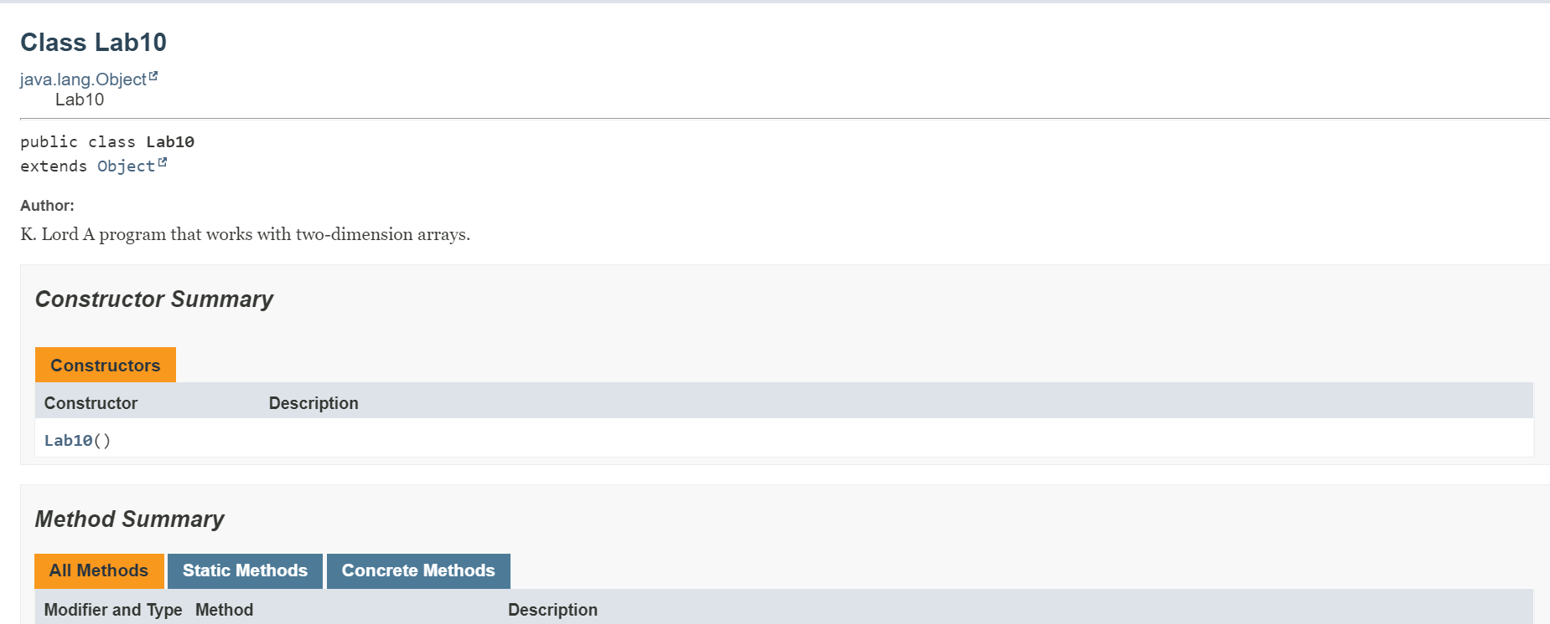
Step 3
Find the path to your doc folder under your Lab10 project in file explorer
Find the index.html file, you can either double click it if your browser is already set to open .html files or right click and use open with to select the browser you would like to open it with

Slide 6
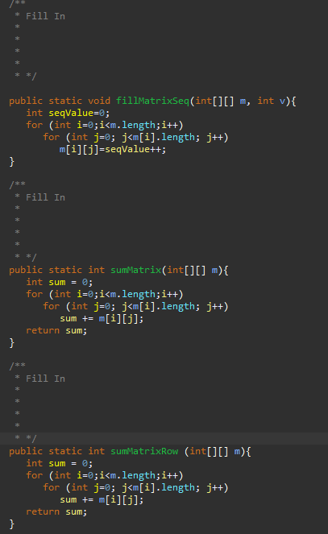
Step 4
Now you will add your own Javadoc comments for the fillMatrixSeq(), sumMatrix(), sumMatrixRow() methods
Follow the example of the comments given for fillMatrix(), describe what the passed parameters are with the @param tag and describe what the method will do (this example does not have a why because it is just for practice)
If you need to run the different methods in the main method to see what they do!

Slide 7
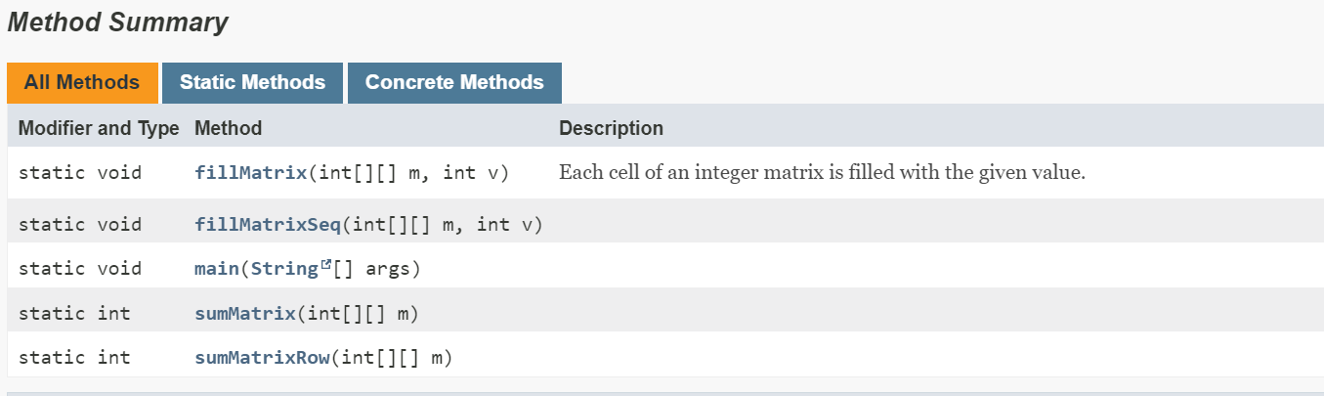
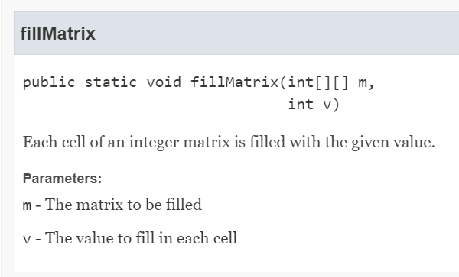
Step 5
Export the Javadoc again to update the Javadoc with the new comments you just added
Open up the index.html file and check to see your comments displayed and organized on the page
You should see descriptions for the other methods on the left and scrolling down find sections like the one on the right for each method you added Javadoc comments for

